Slide 1
Sports / Action Photography: The Art of the Story
March 2024
Derek Cioffi

Slide 2
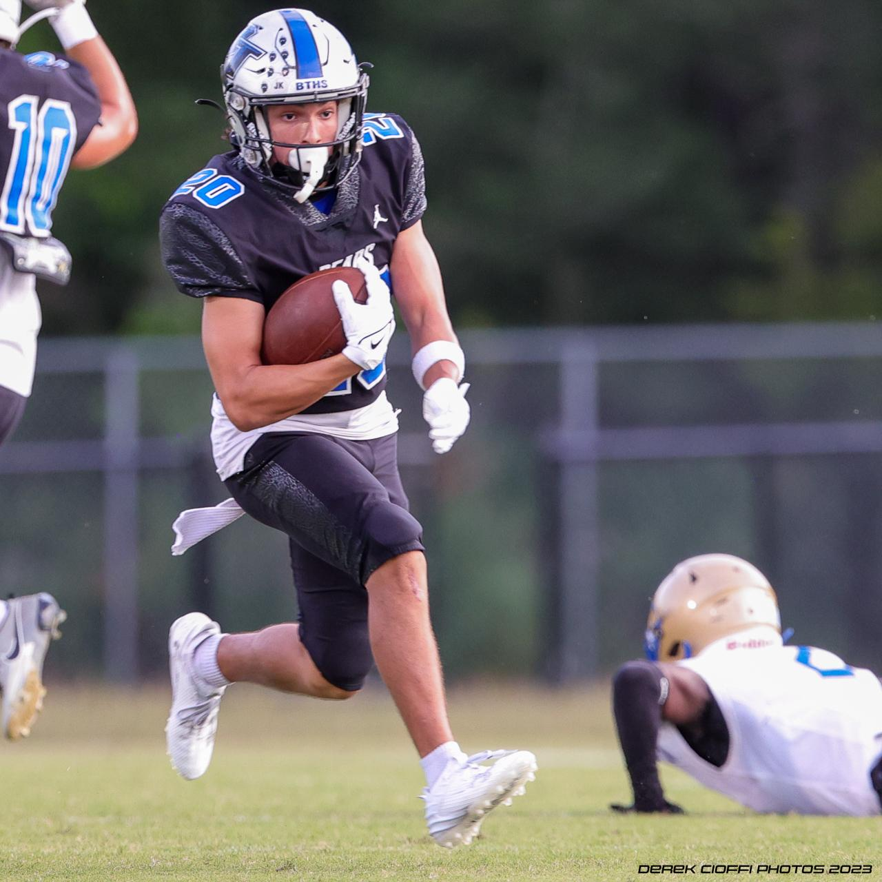
Getting into the Game
Many different approaches to shooting sports/action
The goal is convey a story that makes the feel you feel like you are in the game
Unlike portraits , still-lifes, or even landscapes, Action / Sports photography is different; you are often at the mercy of the game
Notes:
Unlike portraits or landscapes, Action / Sports photography is different; you are at the mercy of the game

Slide 3
Tonight’s Three Act Play
The Setup
Equipment and settings
Must haves versus good to have
The Approach
What and how to take your images
The “Technical” Aspect
The “Creative” Perspective
The Edit
How to pick your keepers and edit them in a way that conveys emotion
Image selection (and deletion)
How to crop (and how not to)
“Noise Reduction is Your Friend”

Slide 4
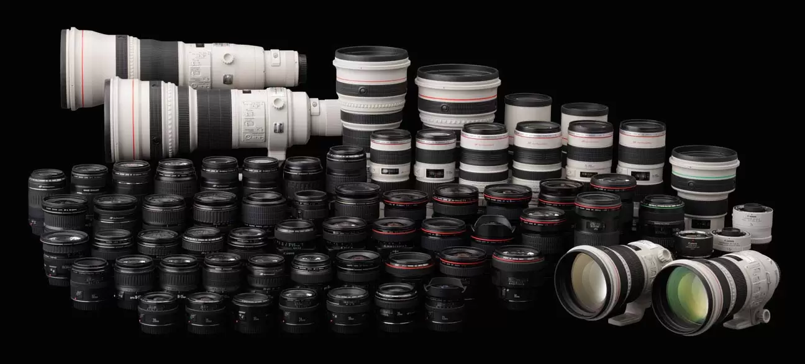
Act One - The Setup: Equipment
Solving the Riddle of Equipment as a Hobbyist
(Without necessarily spending $10,000+)
As of writing, ~$3000-3500 gets you deep into the game

Slide 5
Equipment – What you need
Required
Fast Focus
Soft pics are not keepers
Focus locked on the fan in the stands and not the action will cause premature hair loss and winkles
Eye Focus lives up to the hype, when used correctly
Telephoto zoom lens (70-200mm is a good all around)
High FPS (frames per second)
5+, is workable; 7+ is good; 10+ is great
More Frames = more choices
But - there can be “too much” - Let’s talk about 20+ electronic shutters
Keep in mind, FPS ratings are “max” and not necessarily real world when the lens is focusing & lighting conditions
High ISO capability (usable at >3200+ >25,600)
Monopod - Quick Release helpful

Slide 6
Equipment – What you need
Nice to Have
Vertical Grip
Teleconverter / Extender
Shoulder Strap (vs Neck)
Rain Cover
Knee pads, seat, or cushion (Home Depot bucket)
Mechanical Shutter preferred - Hot Debate!
In the world of mirrorless, mechanical shutters still have a small advantage over electronic due to rolling shutter and banding; select your mechanical, if an option
Flicker Detection for Artificial Lights
Unless you like random “blackouts” and blotches of orange and yellow in your image

Slide 7
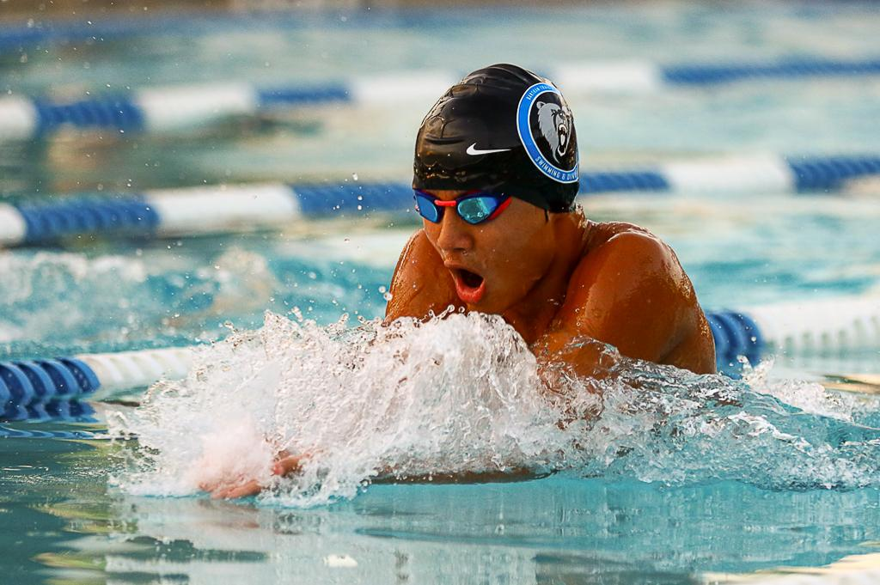
Act Two: Technique – How to Approach a Shoot
The “Technical” Aspect
Use Backbutton Focus and Why
Use Shutter Speed to Freeze Action (min 1/1000sec)
Open Aperture as wide as possible
Maximum FPS allowable
Burst vs Spray and Pray
JPEG vs RAW – pros/cons
Night and indoors
Auto ISO with minimum shutter speed
Enable Flicker Detection

Slide 8
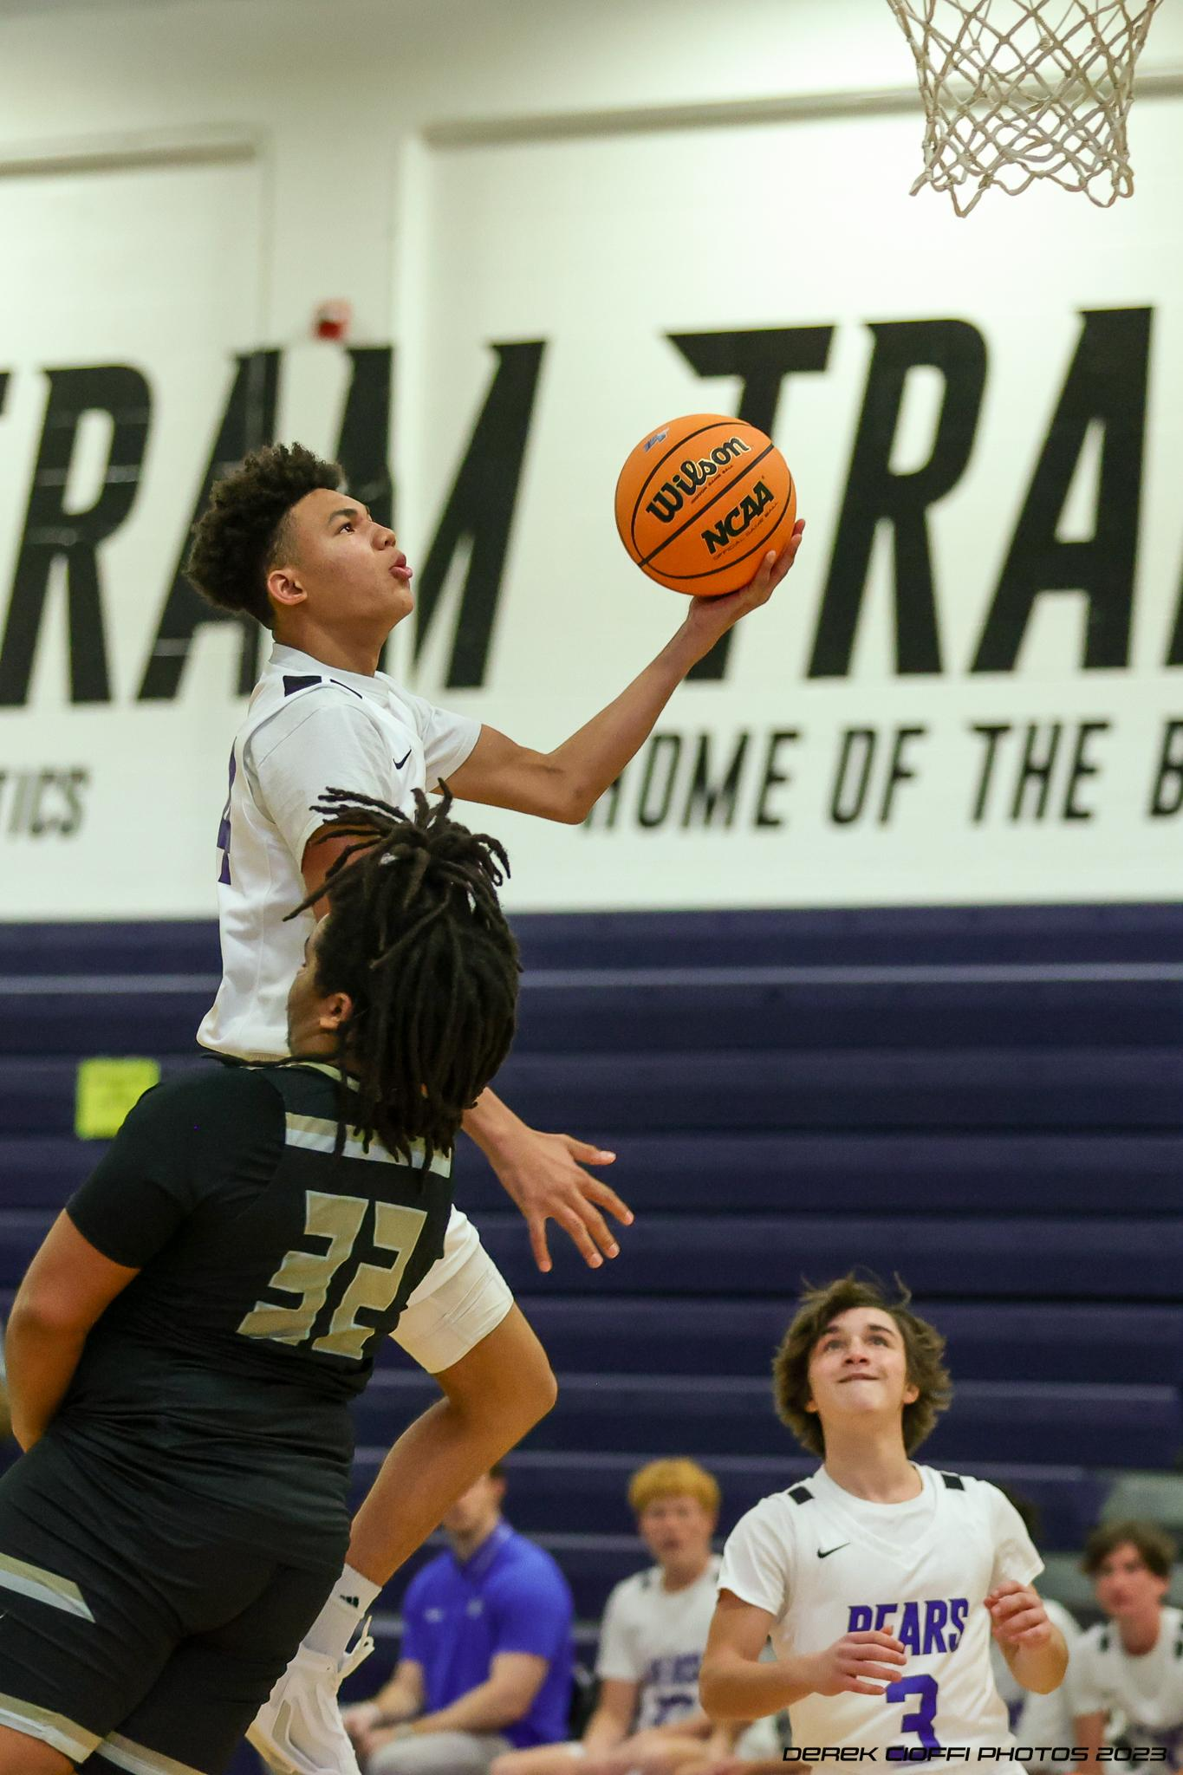
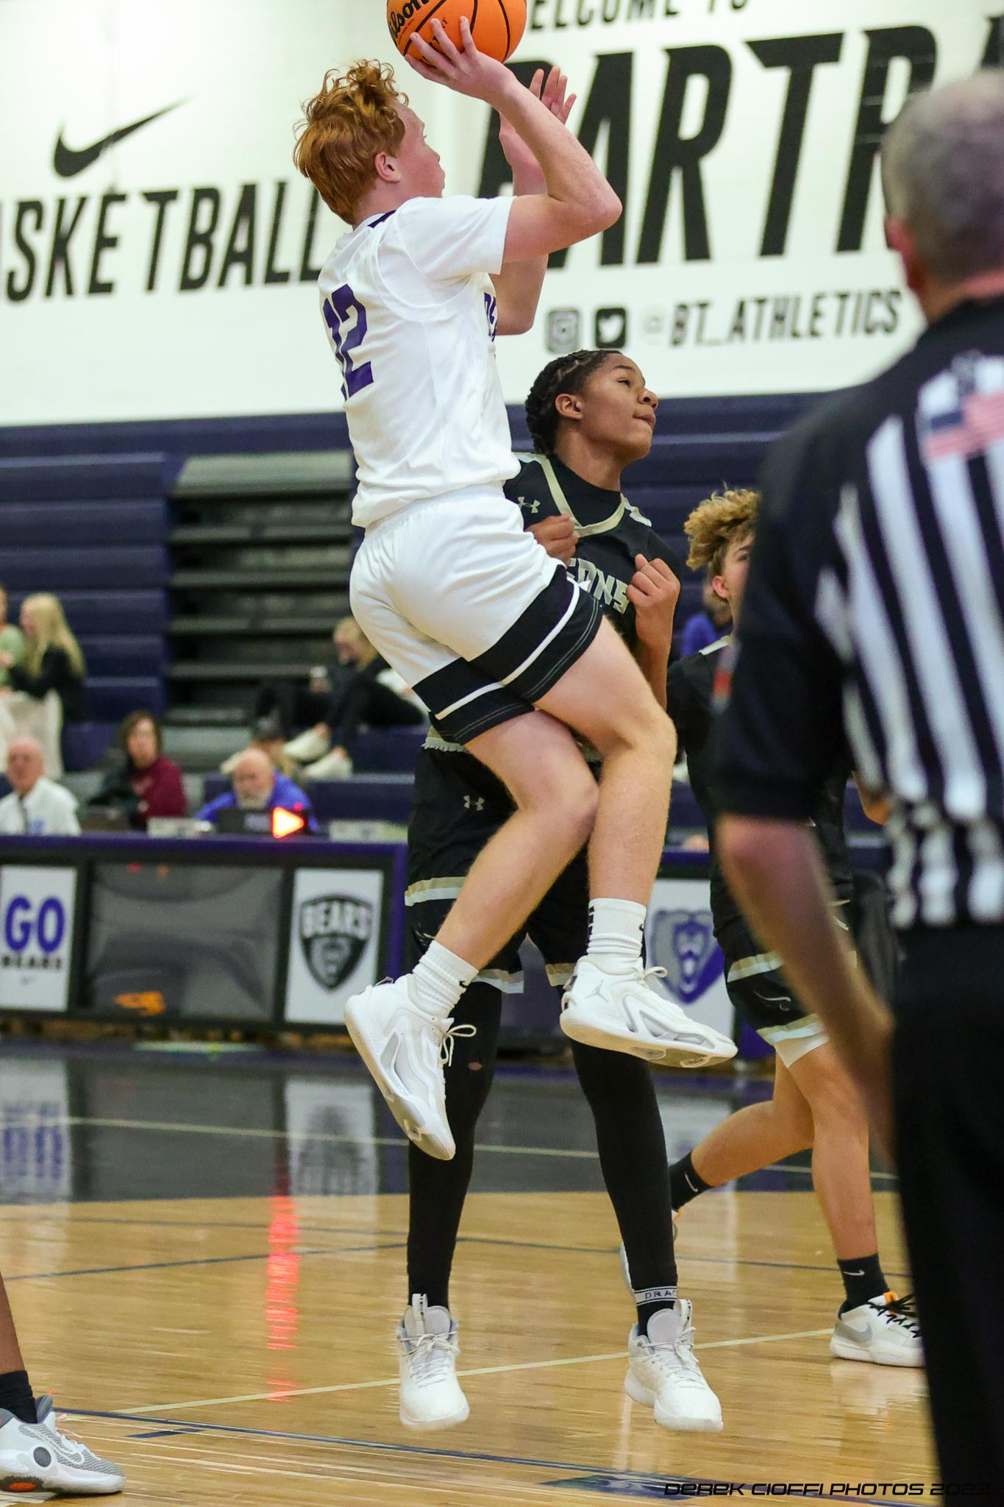
Technique – How to Approach a Shoot
The “Creative” Perspective
Focus on Eyes/Face, ball, and action

Slide 9
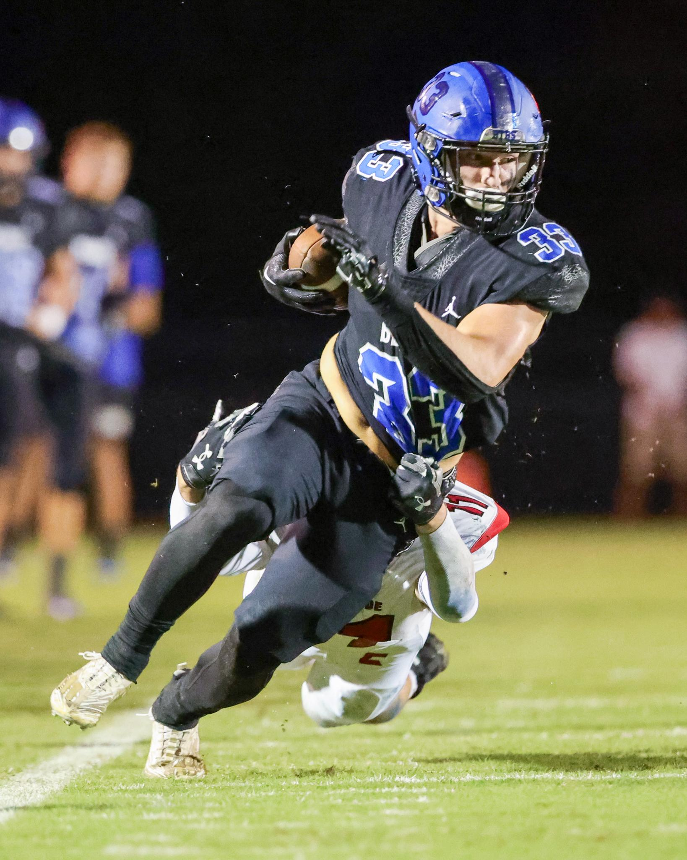
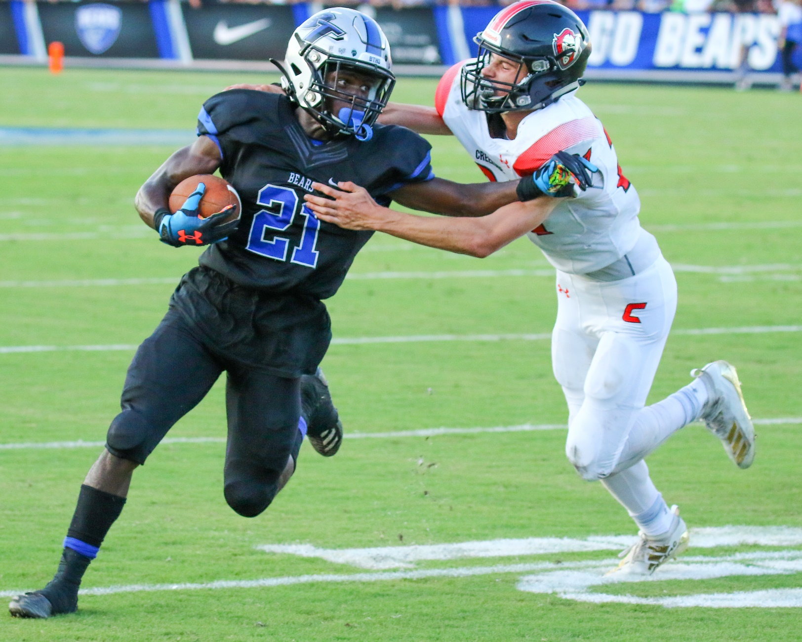
Technique – How to Approach a Shoot
The “Creative” Perspective
Focus on Eyes/Face, ball, and action
Get low
Perspective matters, especially horizon lines

Slide 10
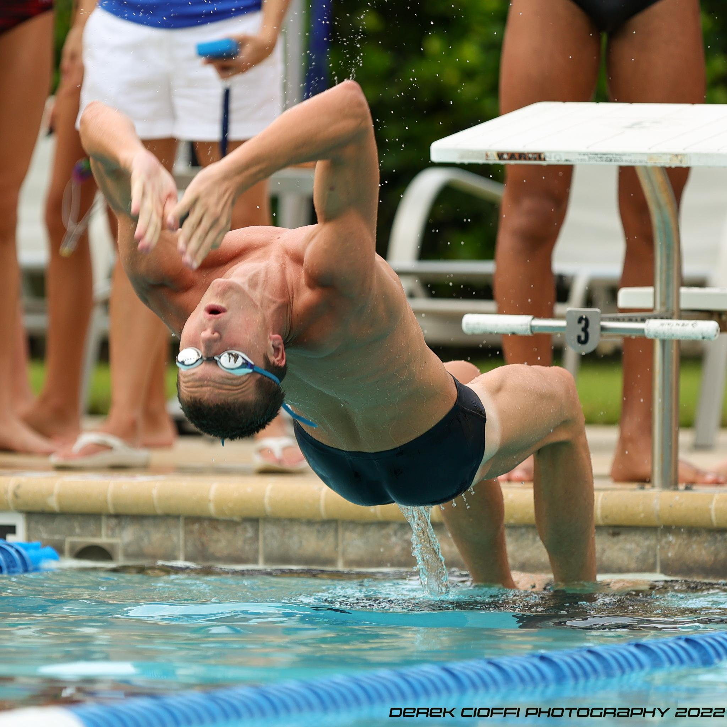
Technique – How to Approach a Shoot
The “Creative” Perspective
Focus on Eyes/Face, ball, and action
Get low
Perspective matters, especially horizon lines
Not all action is equal
Action needs to be relevant
Anticipate Action
Know the sport you are shooting

Slide 11
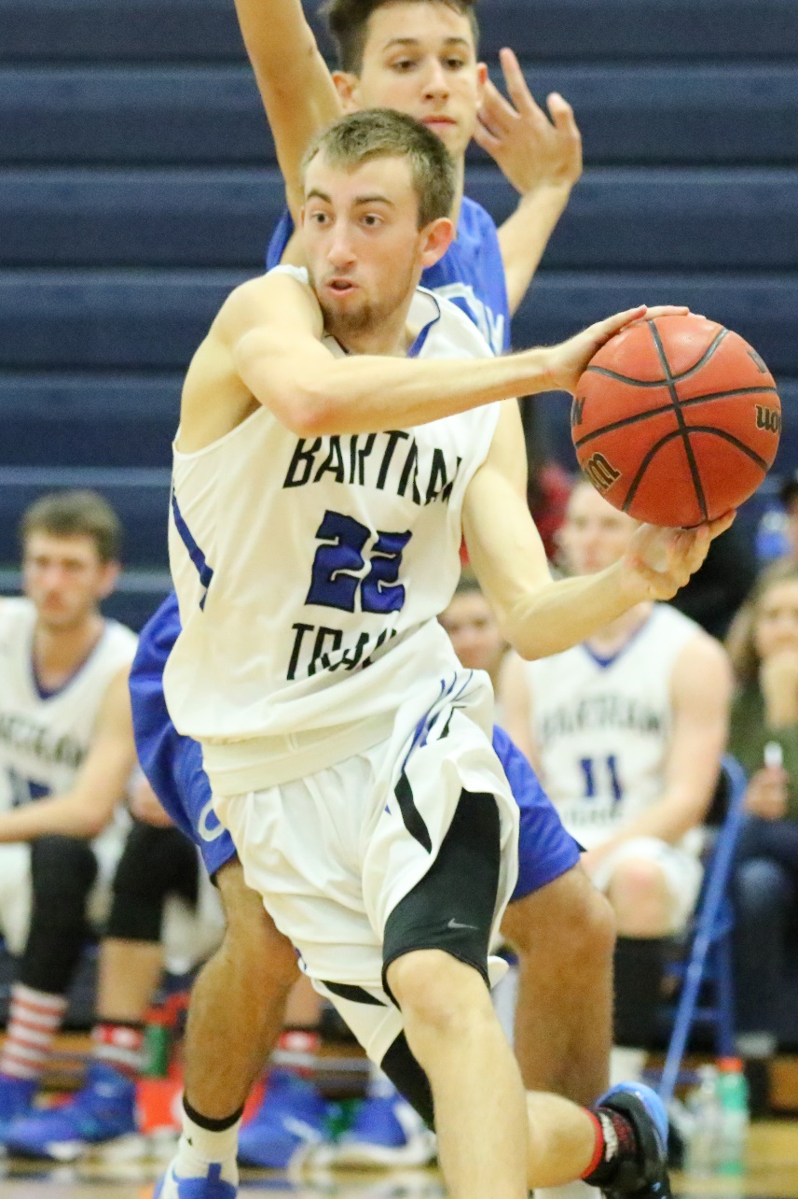
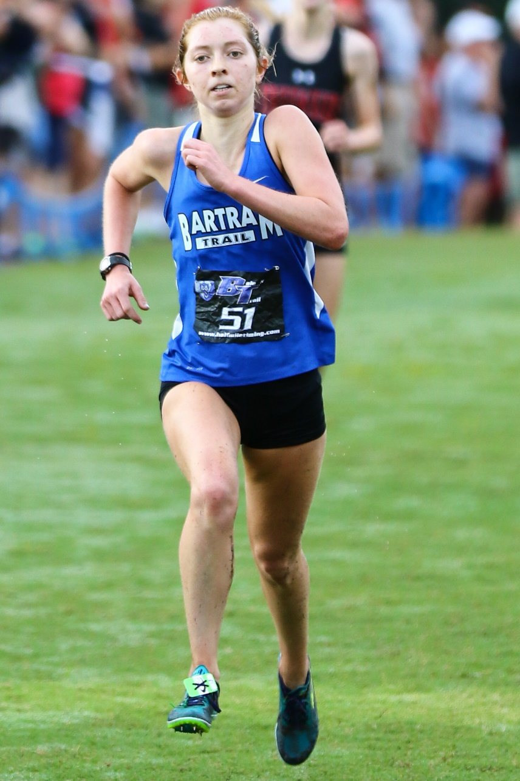
Technique – How to Approach a Shoot
The “Creative” Perspective
Focus on Eyes/Face, ball, and action
Get low
Perspective matters, especially horizon lines
Not all action is equal
Action needs to be relevant
Anticipate Action
Know the sport you are shooting
Vertical Shooting is often better – focus and crop

Slide 12
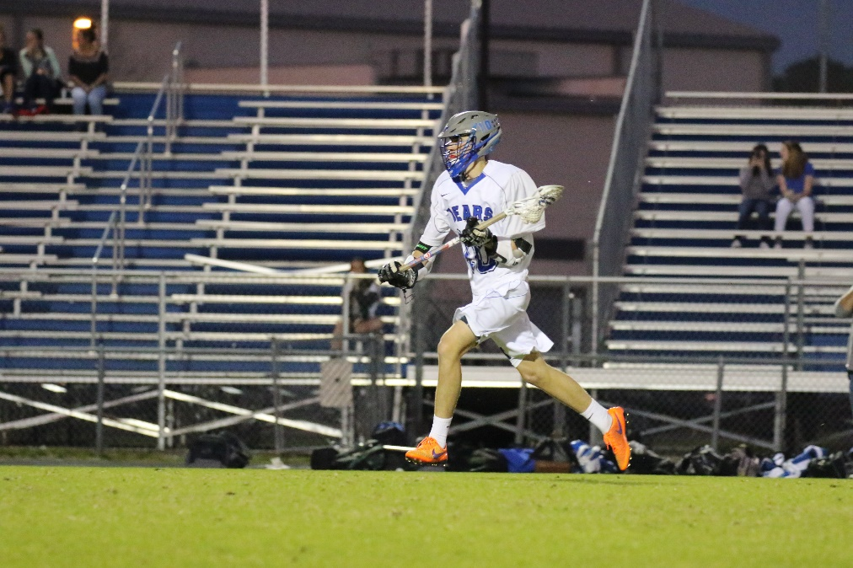
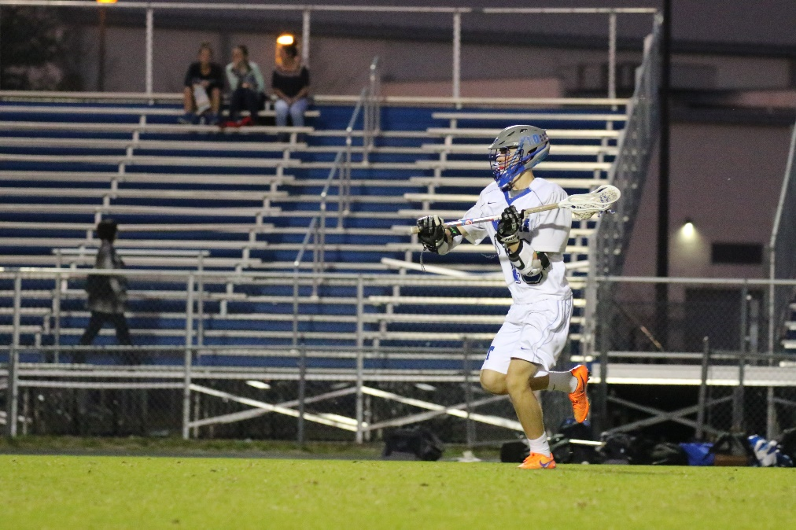
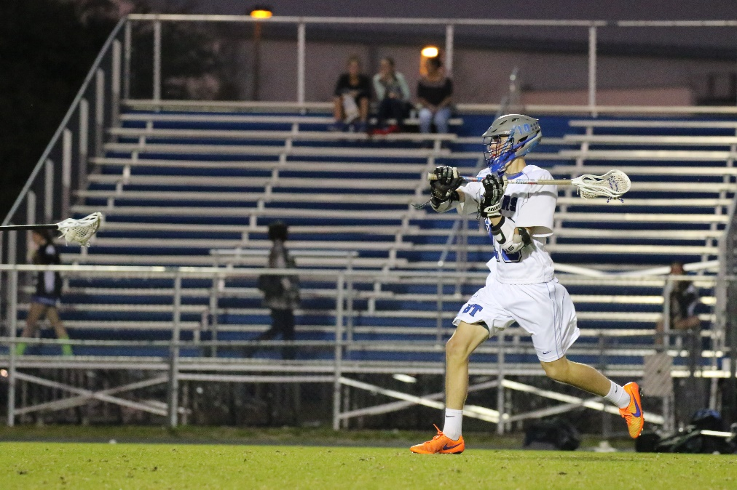
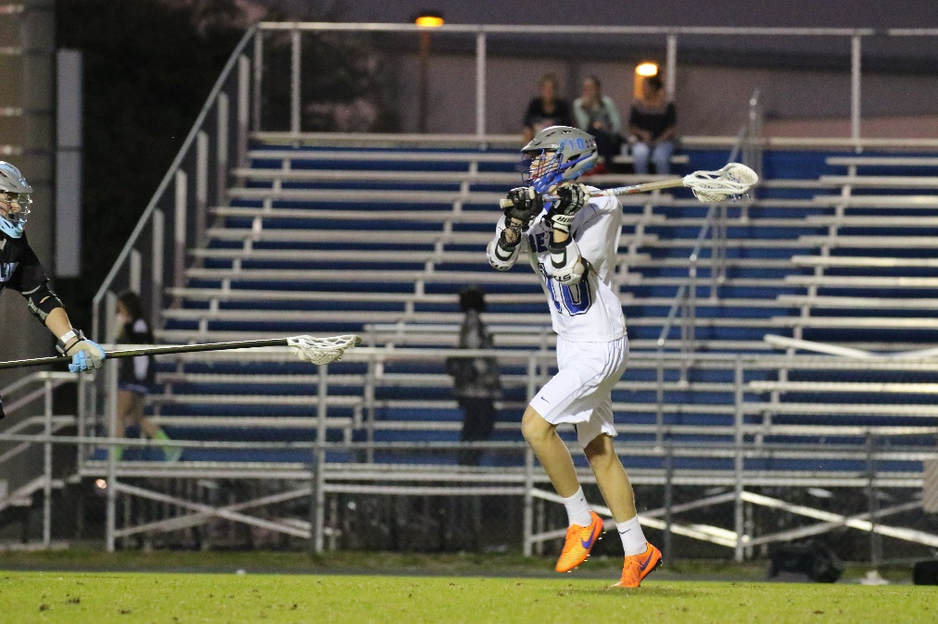
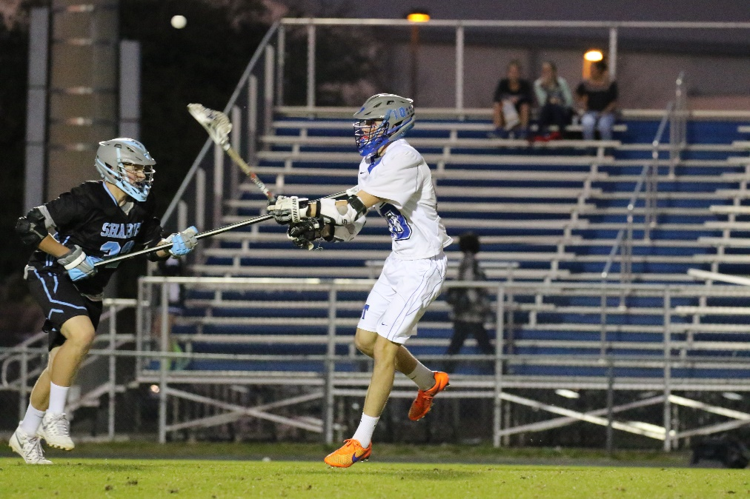
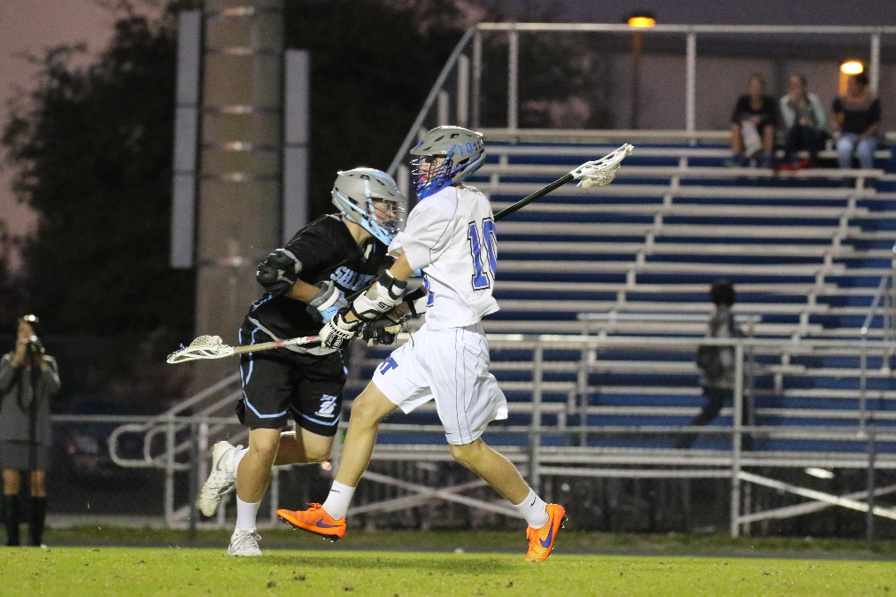
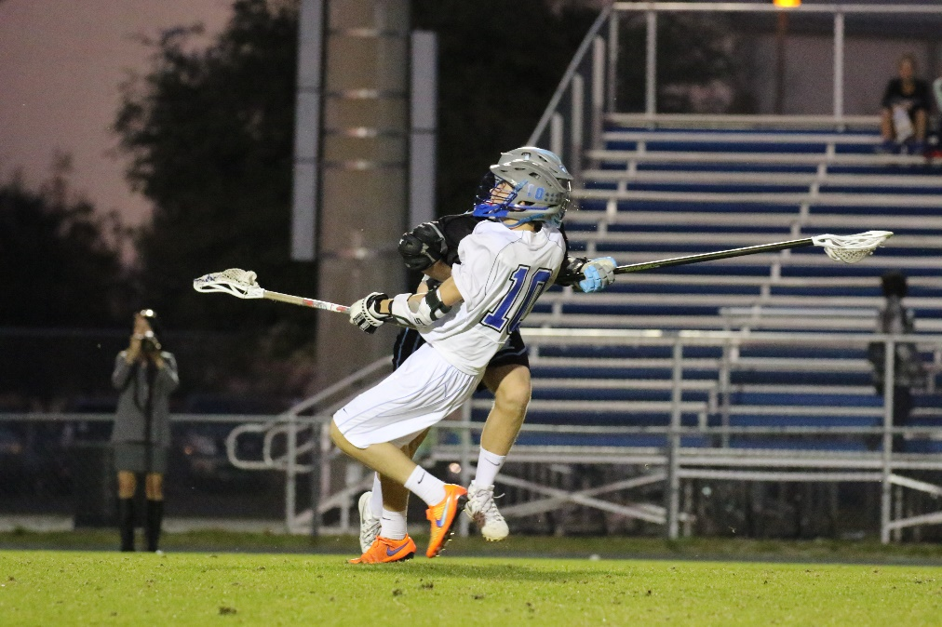
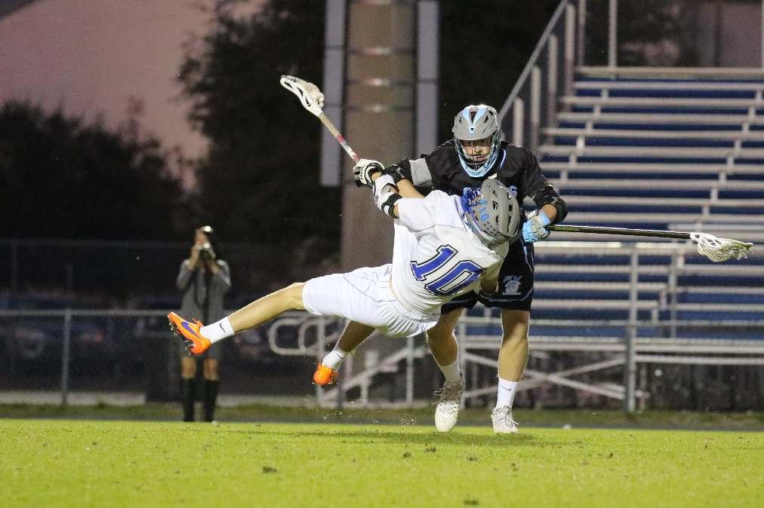
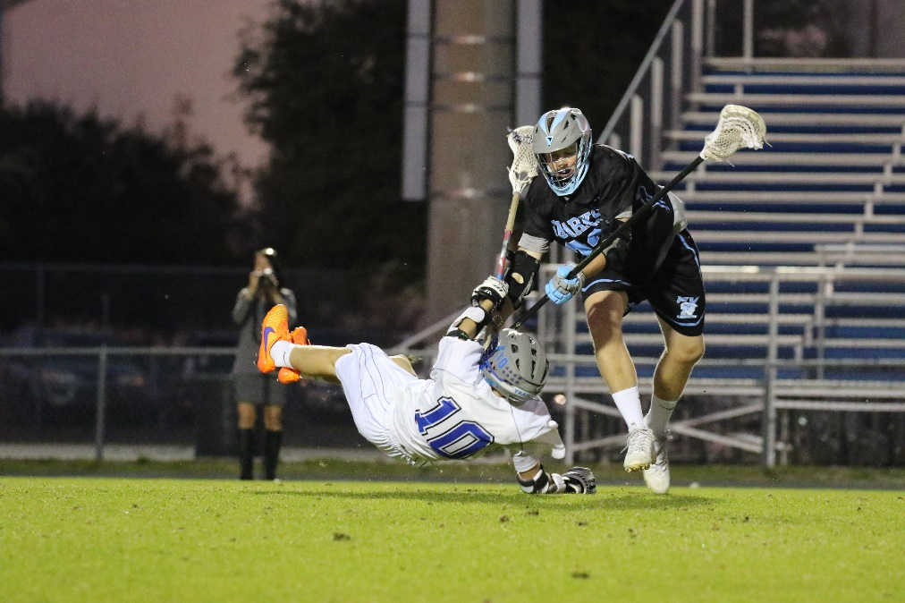
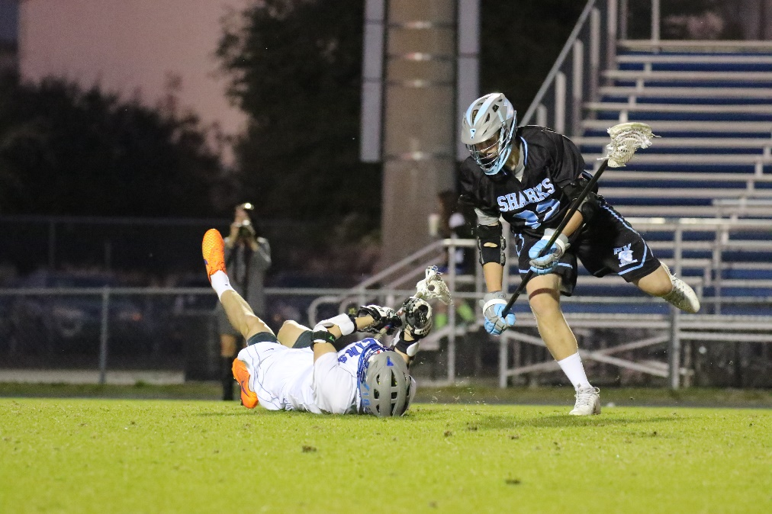
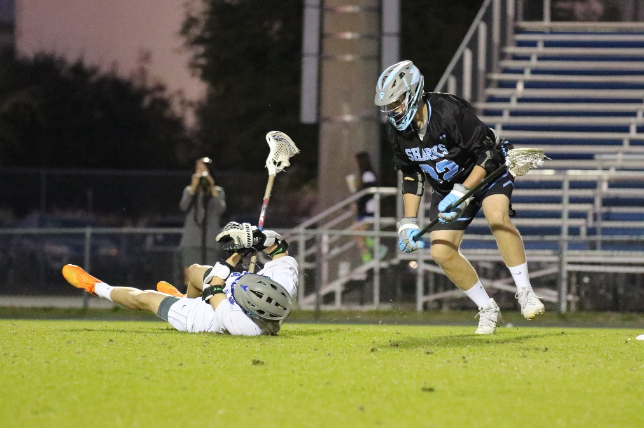
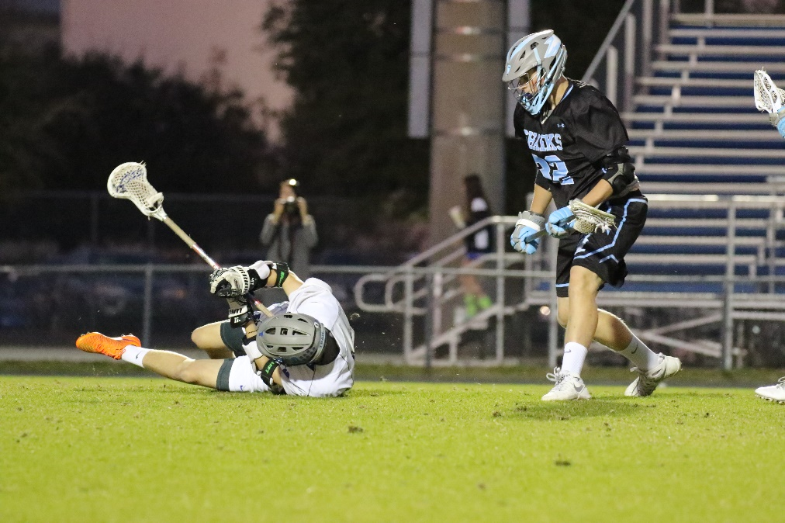
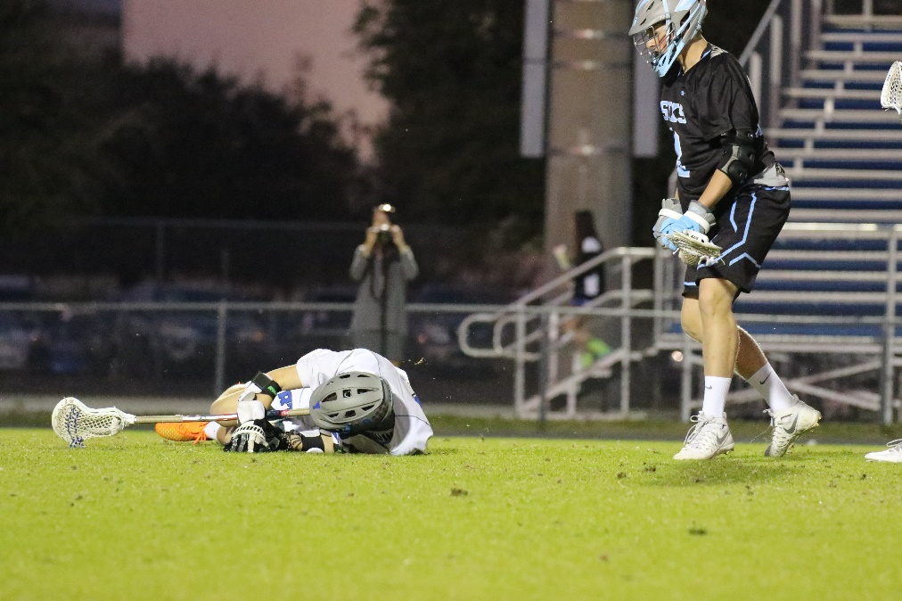
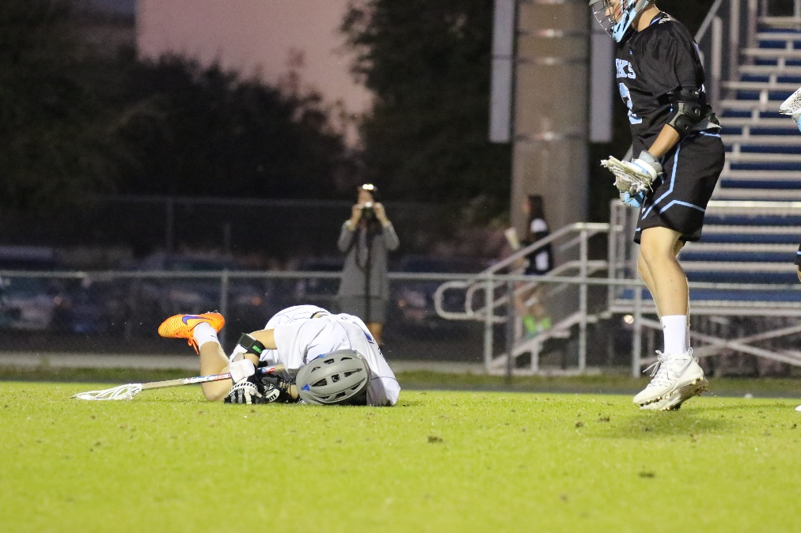
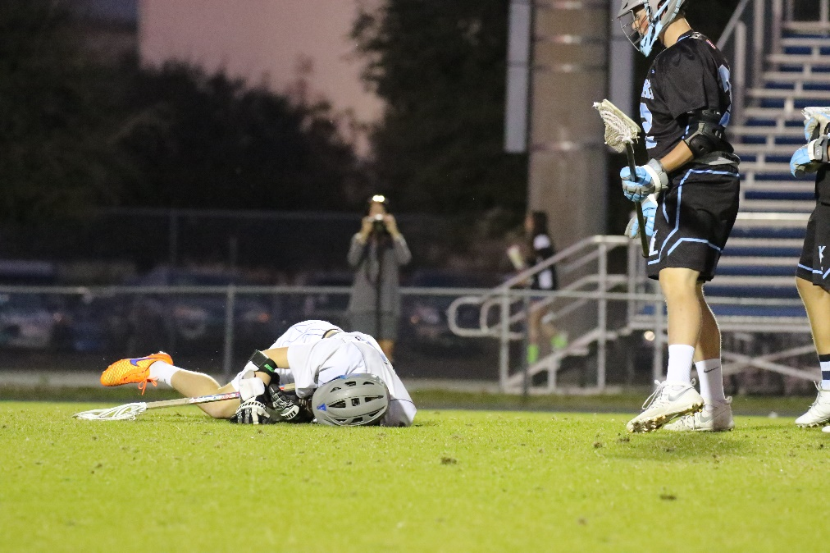
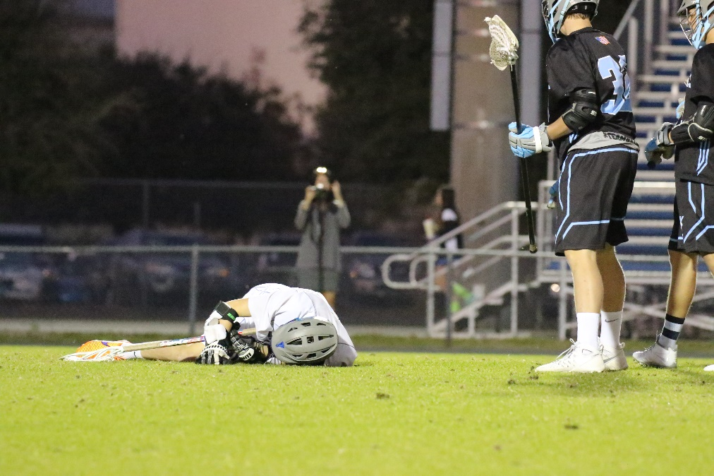
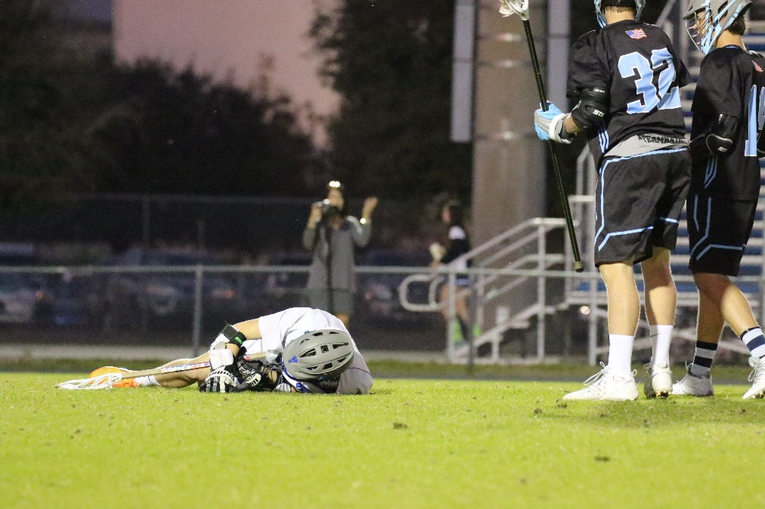
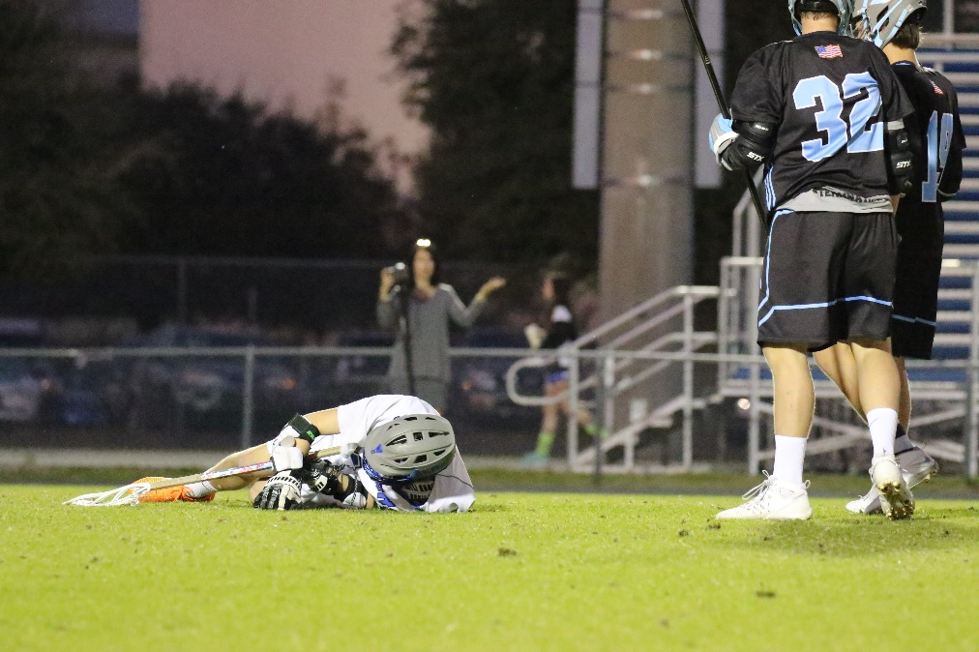
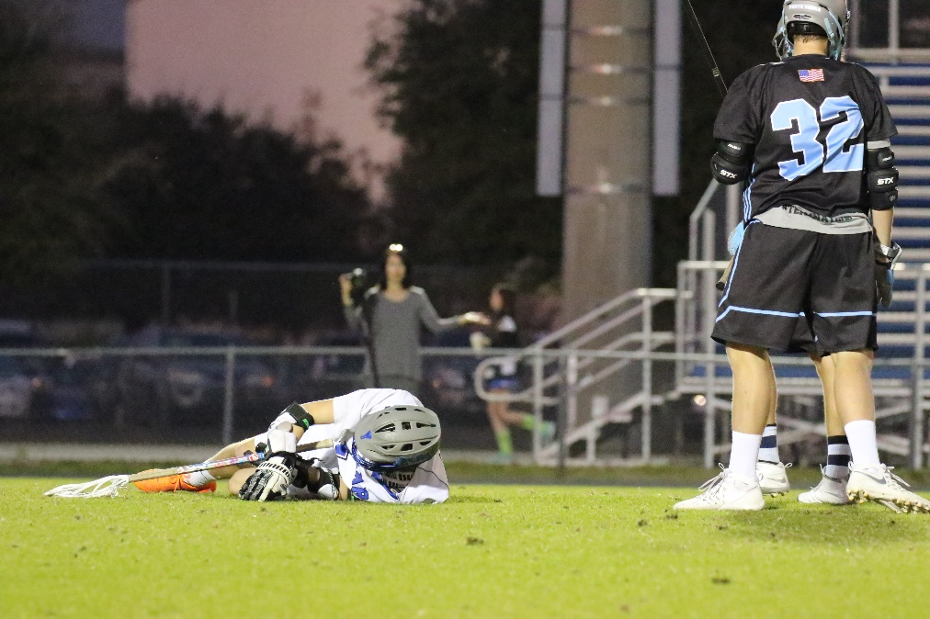
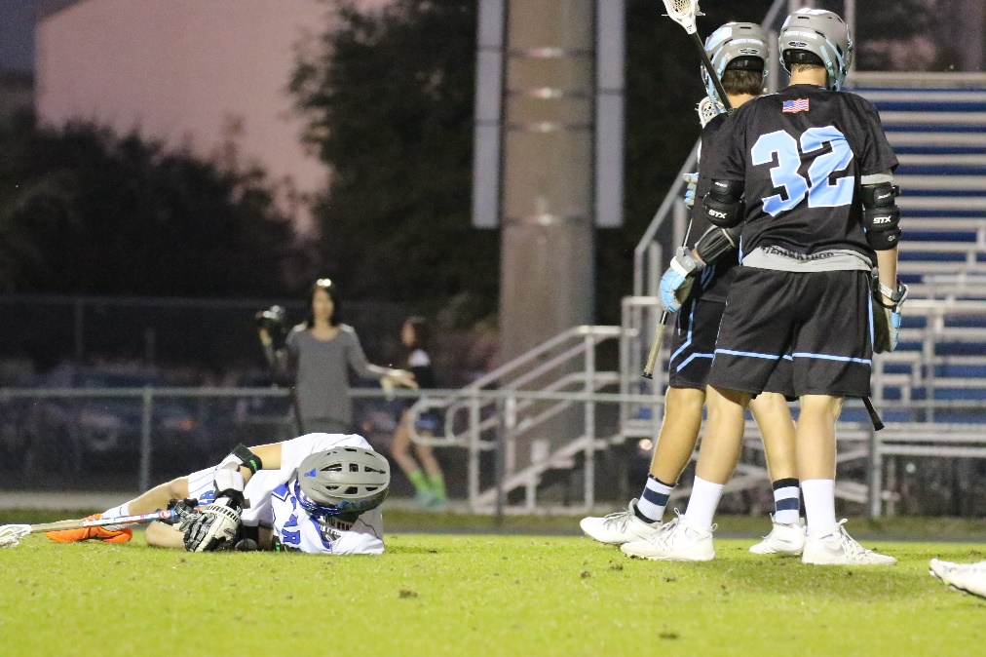
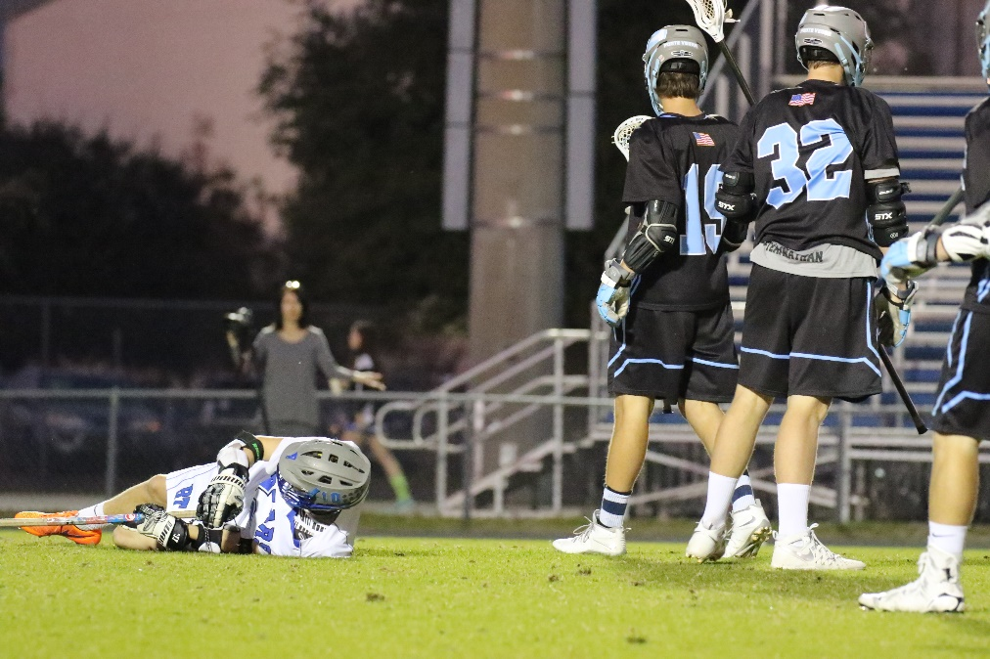
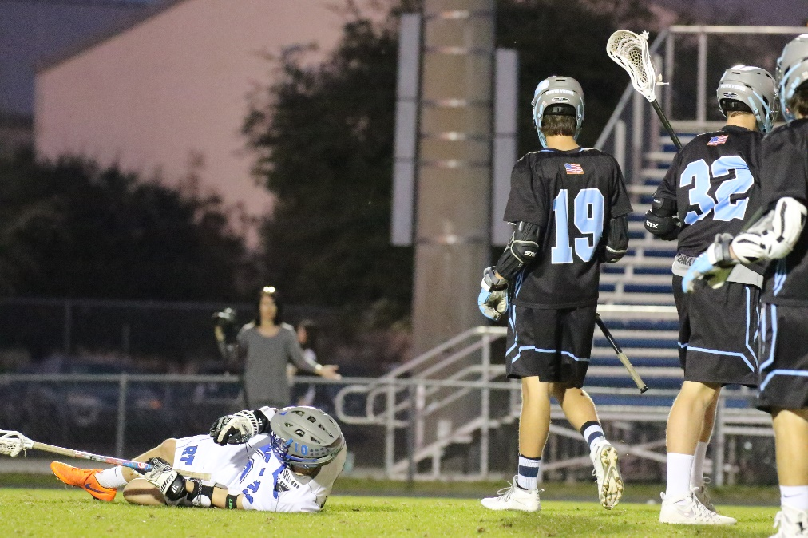
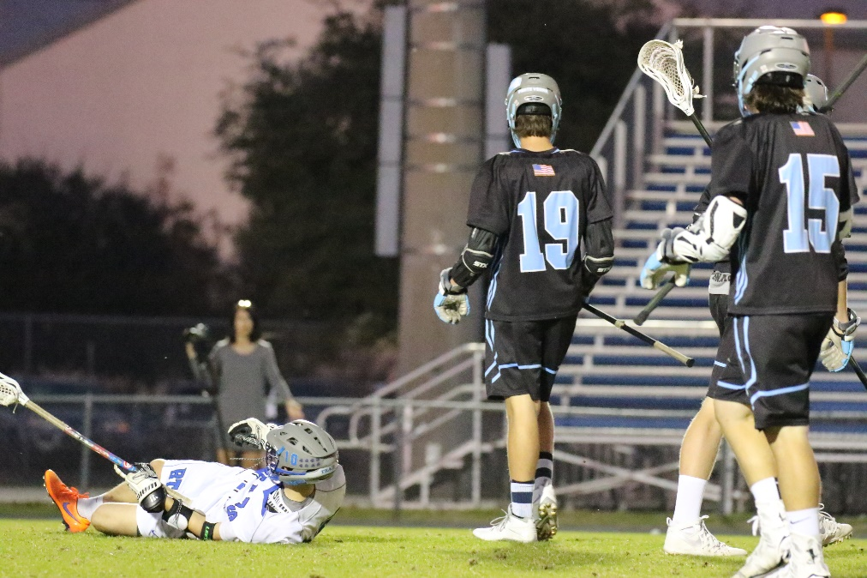
Technique – How to Approach a Shoot
The “Creative” Perspective
Focus on Eyes/Face, ball, and action
Get low
Perspective matters, especially horizon lines
Not all action is equal
Action needs to be relevant
Anticipate Action
Know the sport you are shooting
Vertical Shooting is often better – focus and crop
Start shooting before you see something happen
If you wait, until you see something you will miss
Expect a select keeper rate of only 10%
Keep shooting after the play – Celebrations/Agony of Defeat

Slide 13
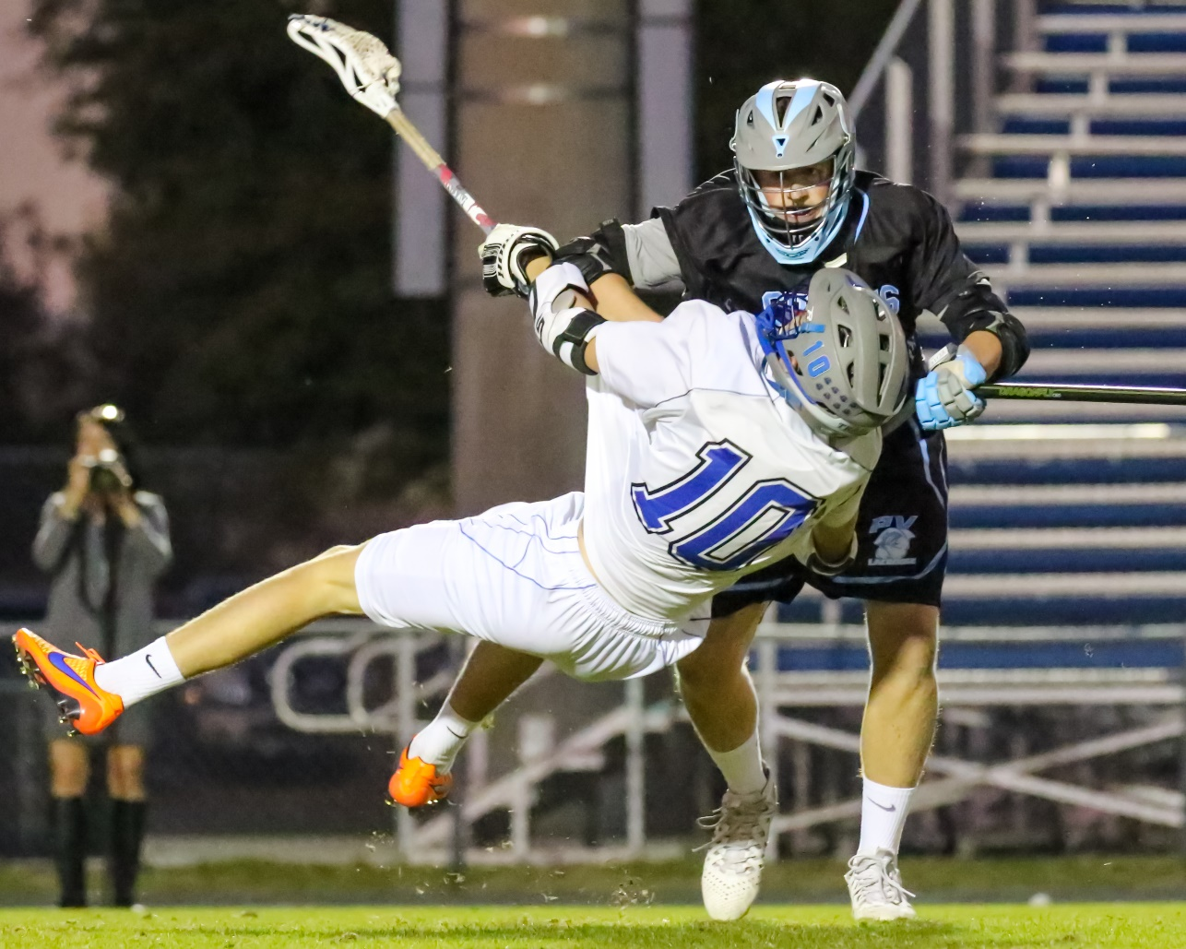
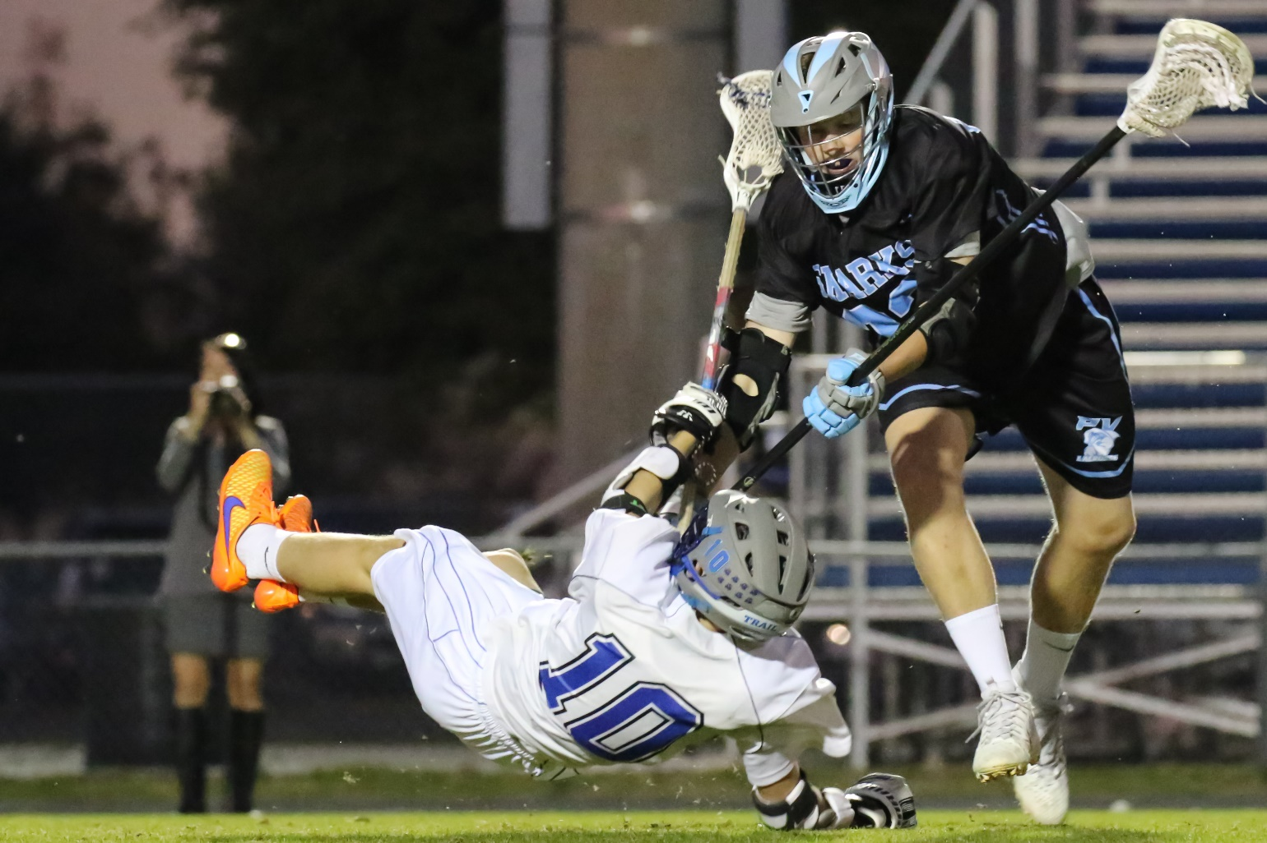
Final Images

Slide 14
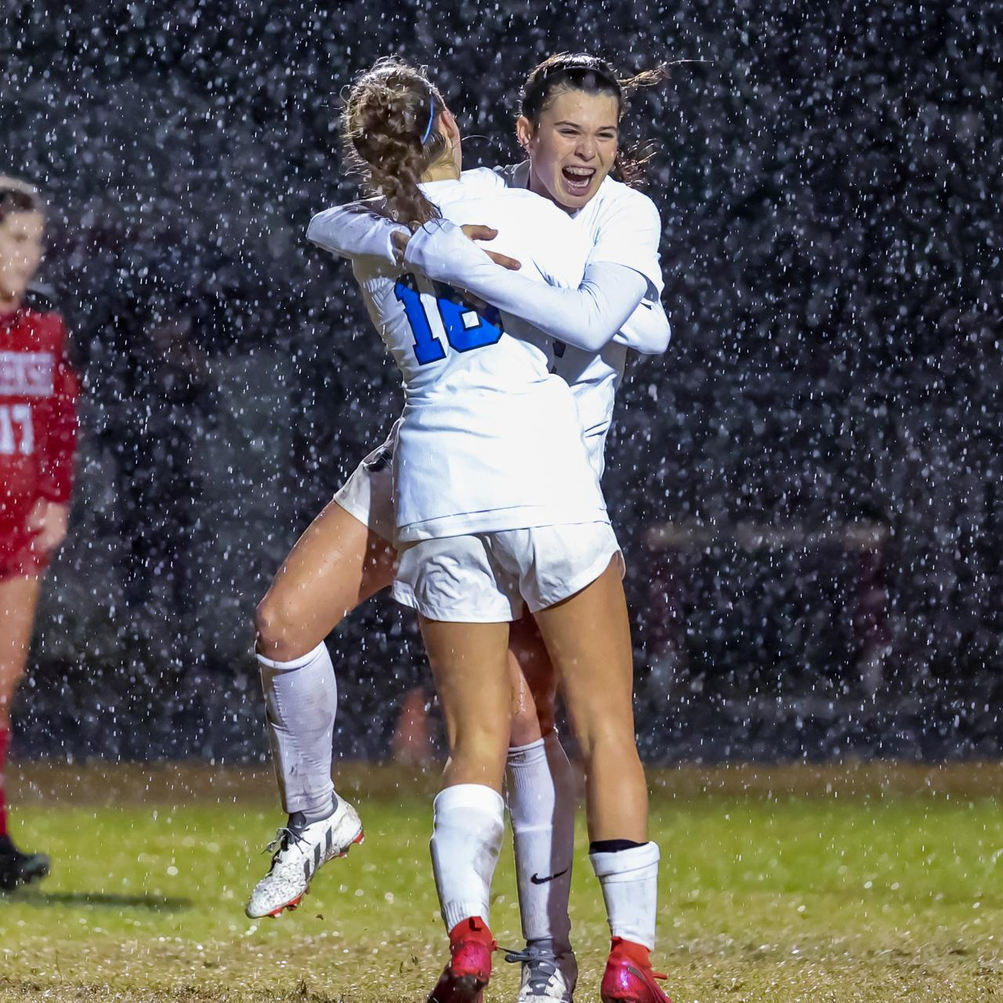
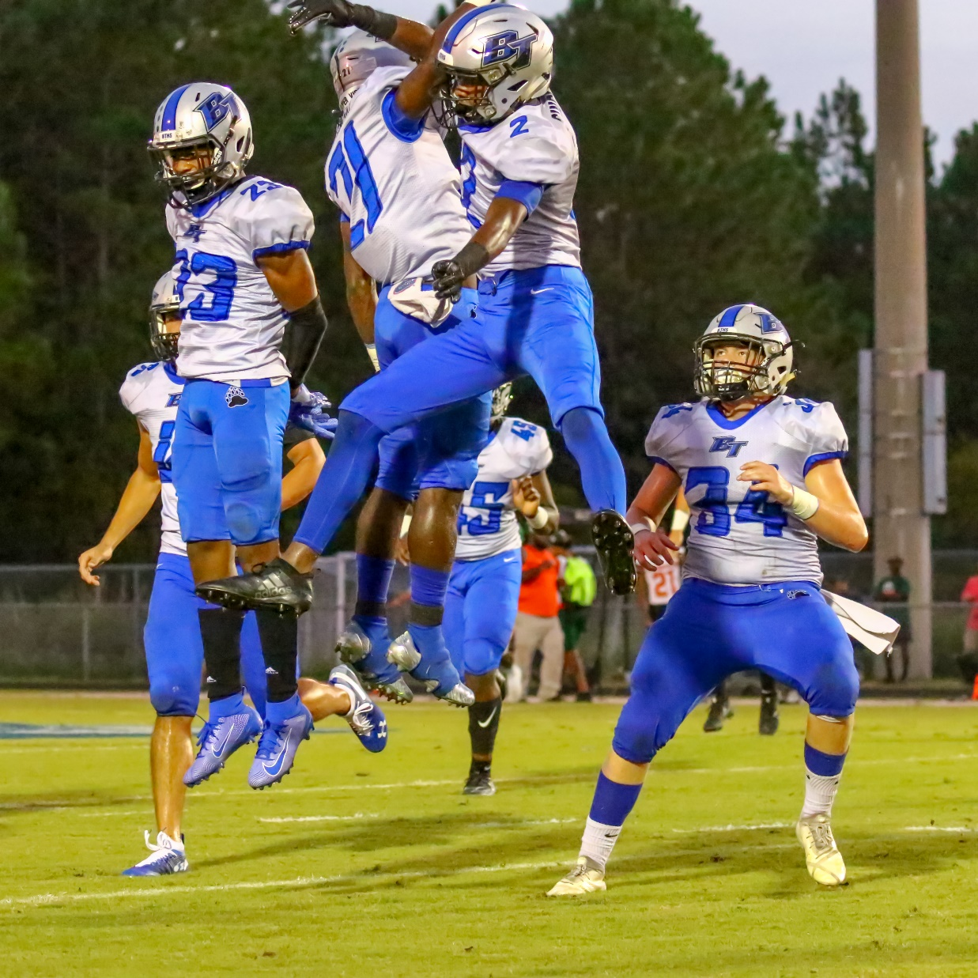
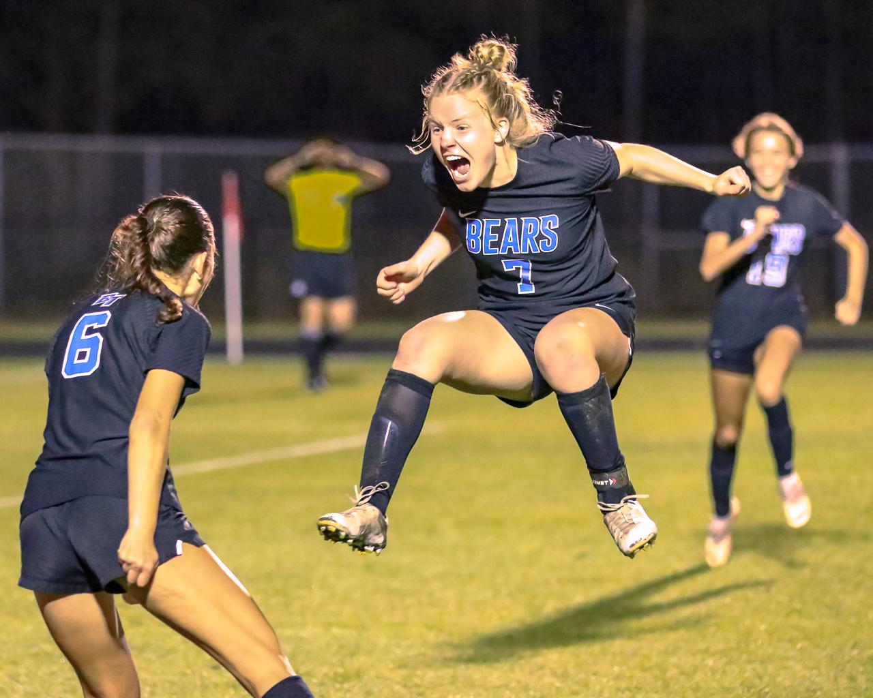
Celebrations

Slide 15
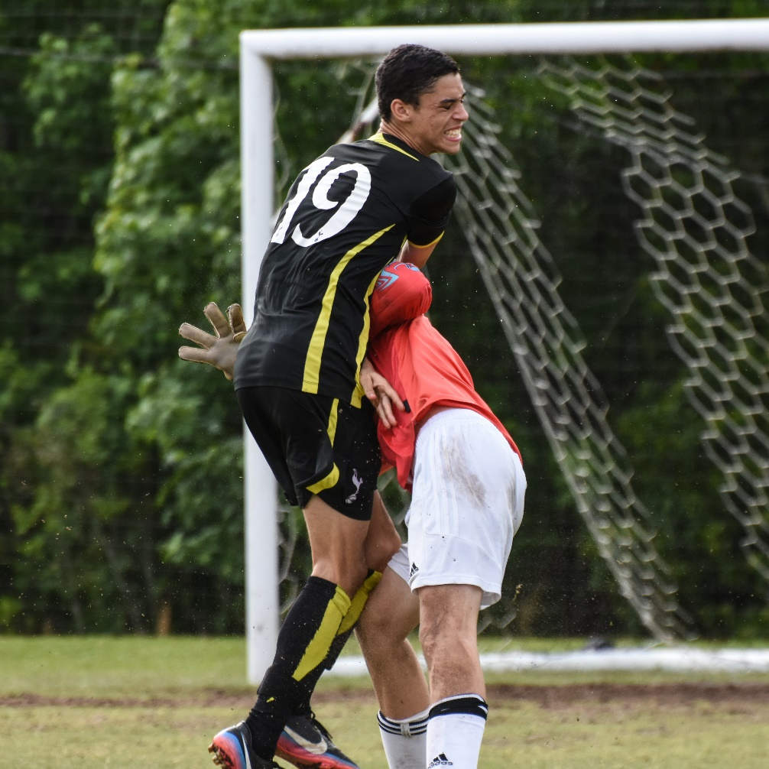
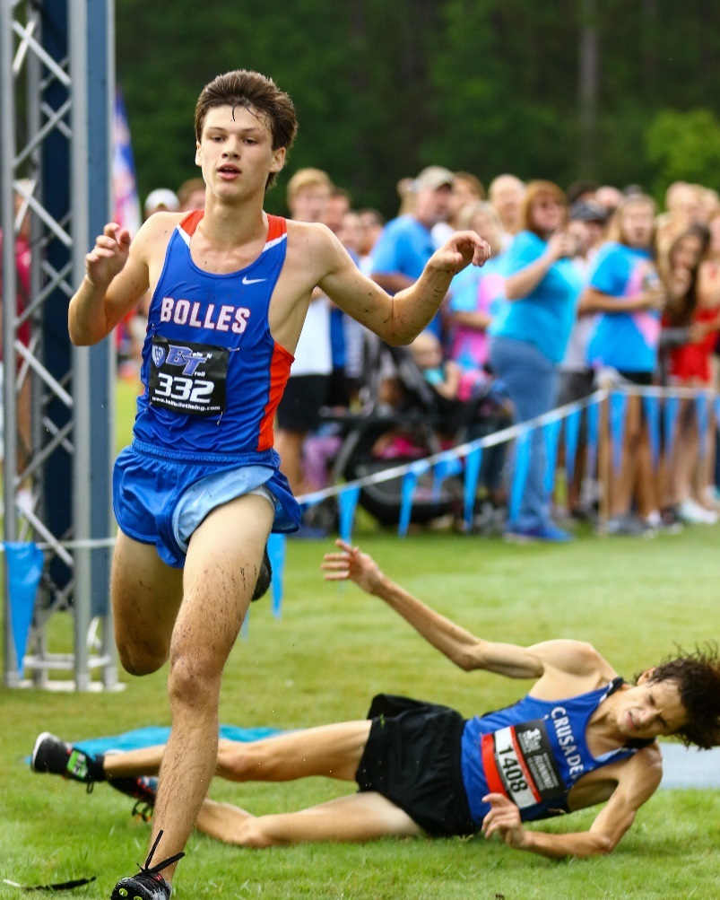
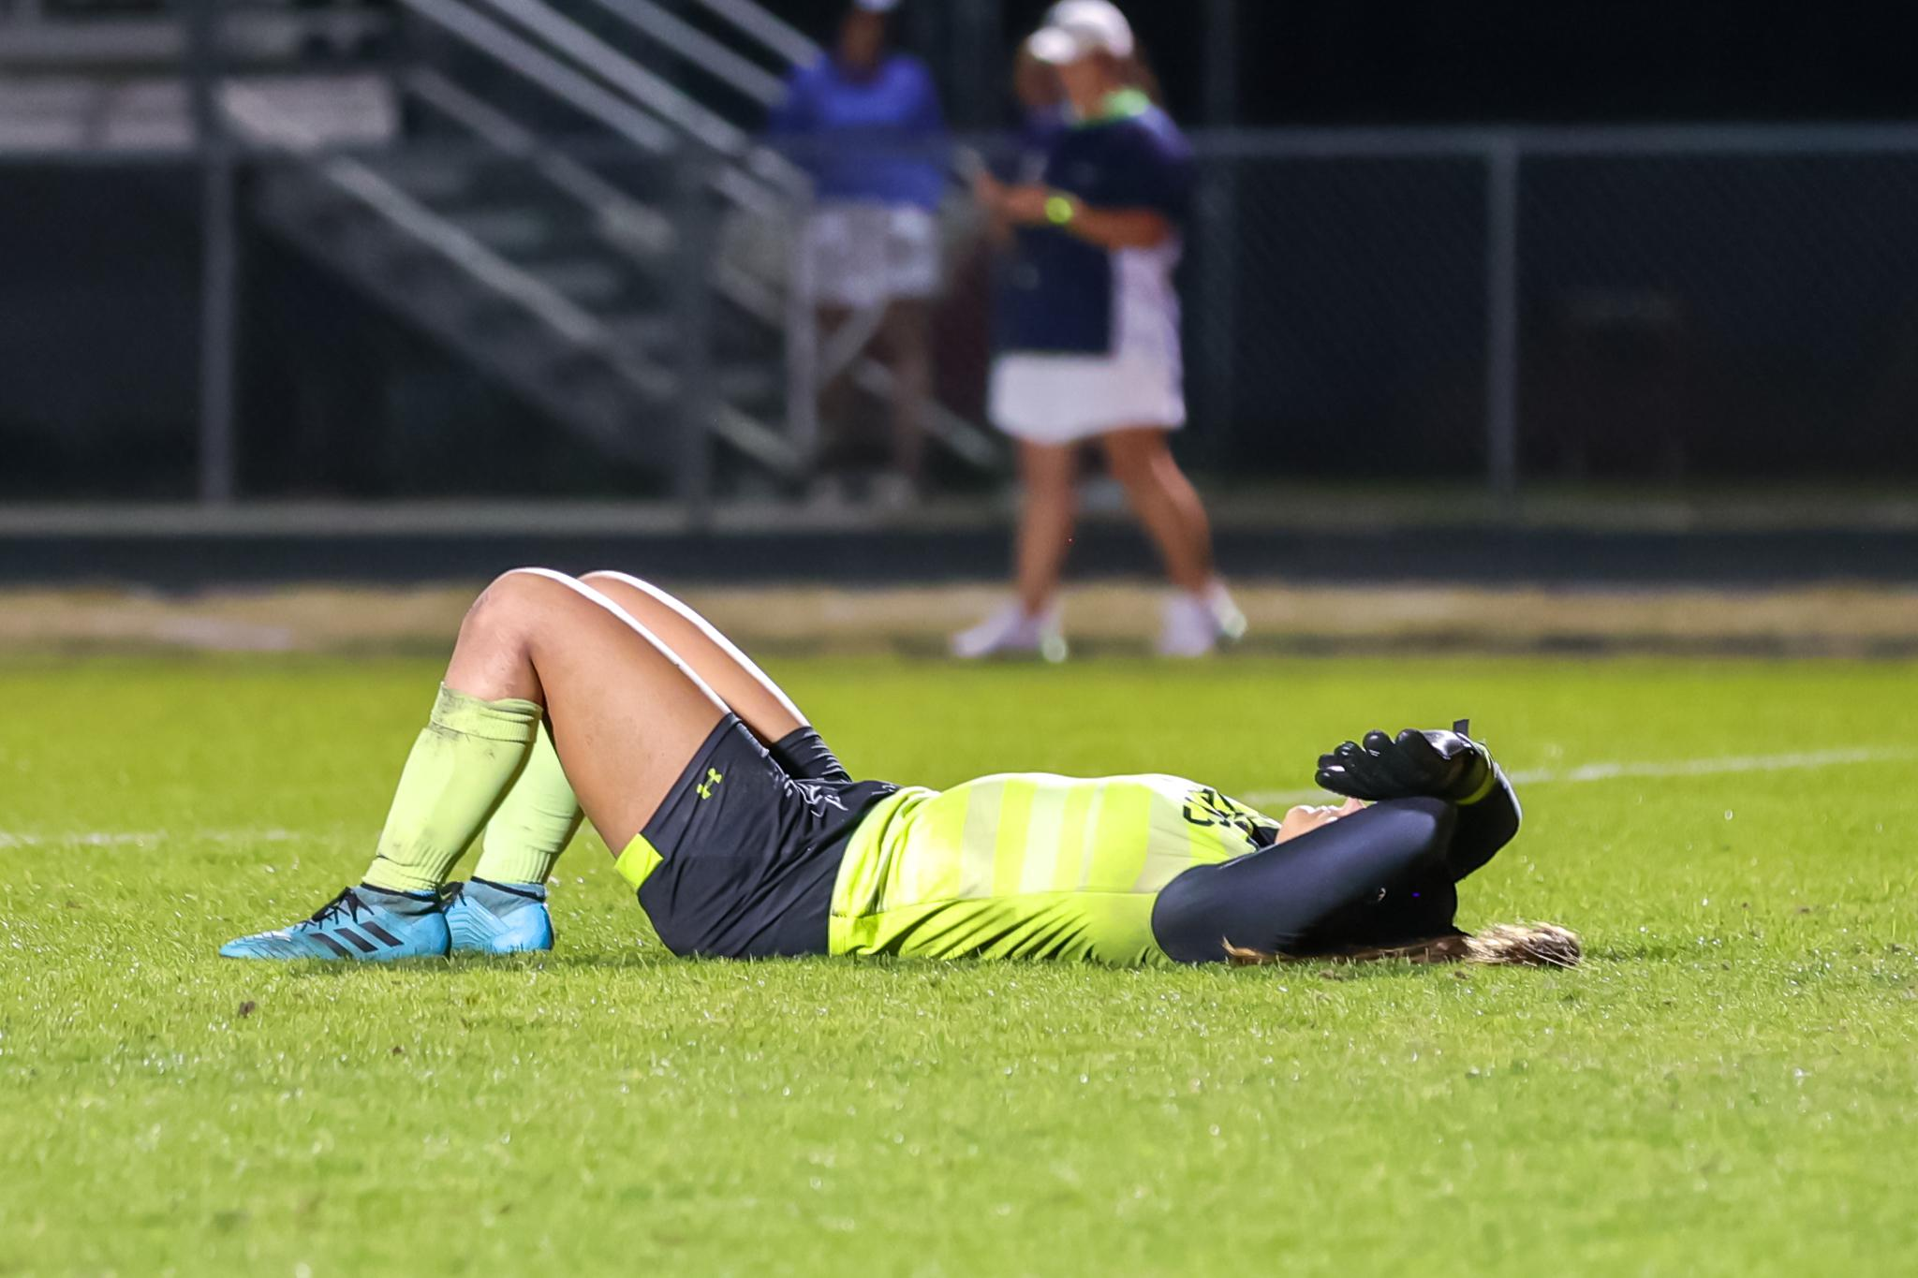
Agony of Defeat

Slide 16
Act 3: Post Processing and Editing
Image selection (and deletion)
How to crop (and how not to)
“Noise Reduction is Your Friend”

Slide 17
Image Selection
Should be titled “How to delete”
Expect 10% of 10% of total images taken – 2-3% net on selects
Average football, soccer, or lax game = 1000+ images; typically get to 100 keepers; and 30 selects
Pick shots that follow the “eyes, ball, action recipe”
Pick shots that show dynamic action – example: runner with both feet off of the ground
Delete:
Non-recipe shots - Action, Ball, Eyes
Soft / missed focus
Truncated limbs
Boring or duplicative

Slide 18
Cropping
Crop in tightly…then crop some more - Get in tight
But…Don’t cut off limbs
And…Give space for the motion of the athlete – don’t box them in
Straighten horizon – it impacts the image
Aspect ratio is subjective – be creative; Online and Social media favors 1x1 and 4x5
Export to limits of platform
e.g. Facebook doesn’t support anything more than 2048px wide and will compress photos other than 720px, 960px or 2048px wide
Instagram limits to 320px to 1080px wide (within 1.91x1 and 4x5 aspect)

Slide 19
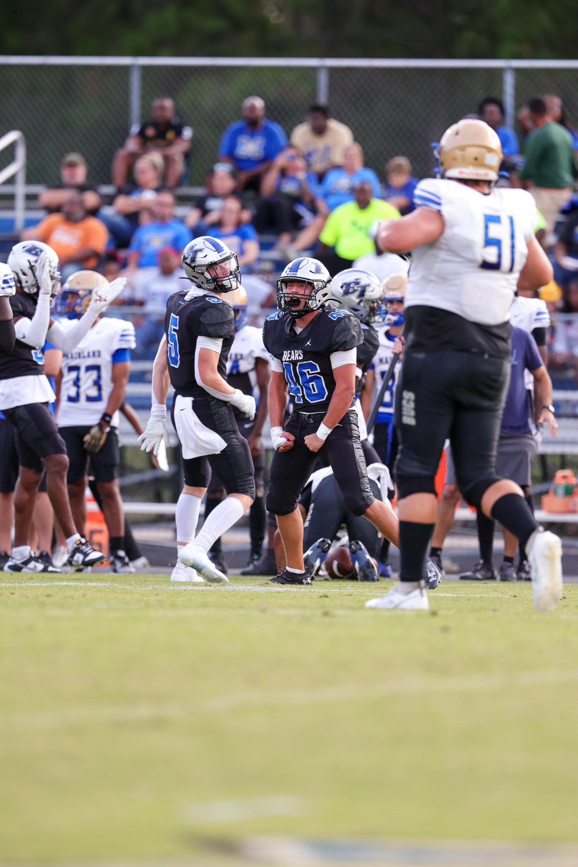
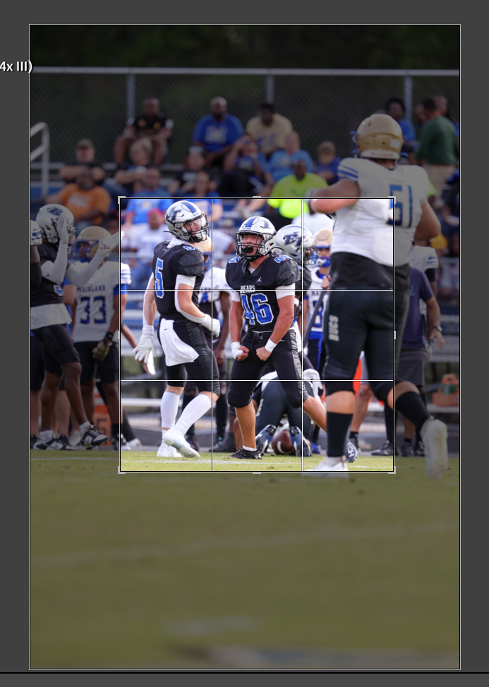
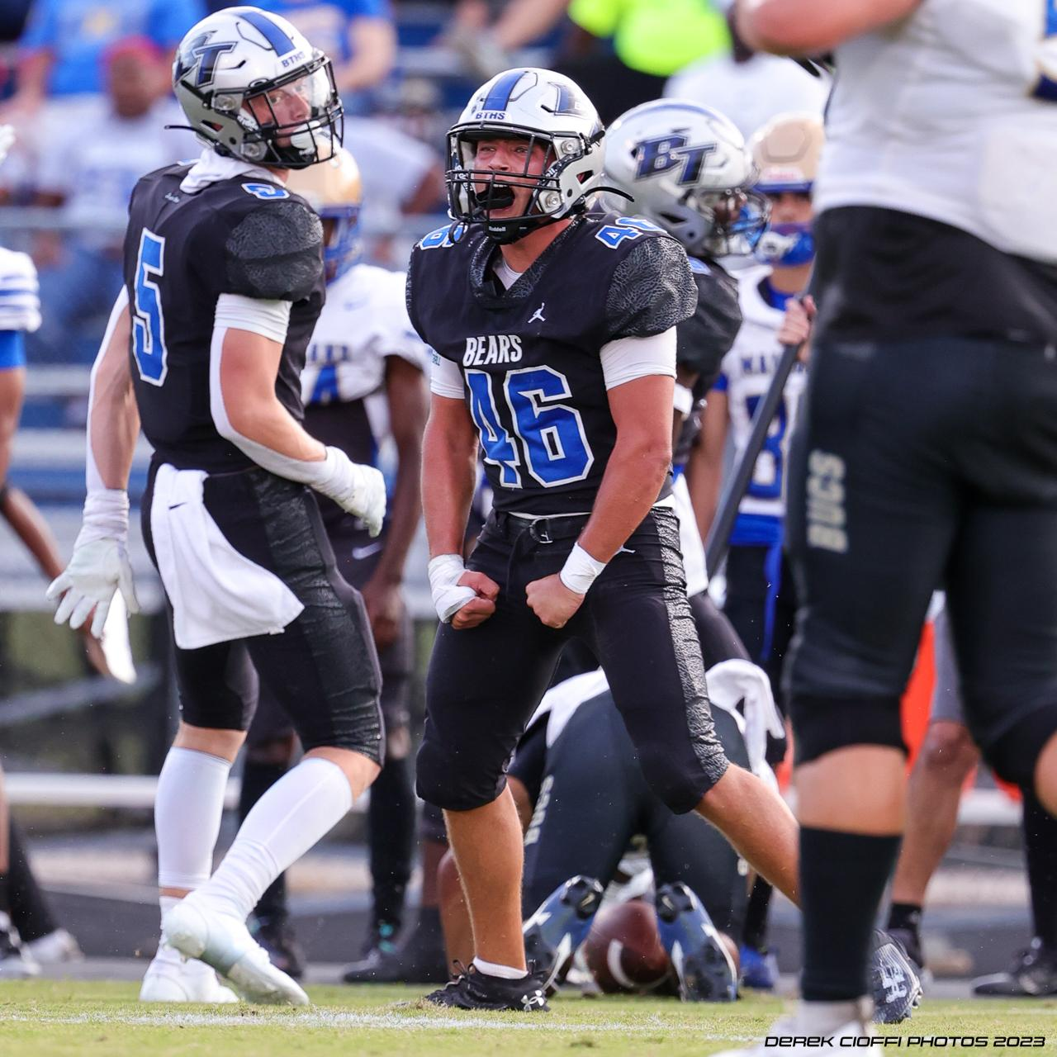
…then crop some more
Crop, Crop, Crop
Notes:
Eliminate items not essential to the Story; choose your own crop

Slide 20
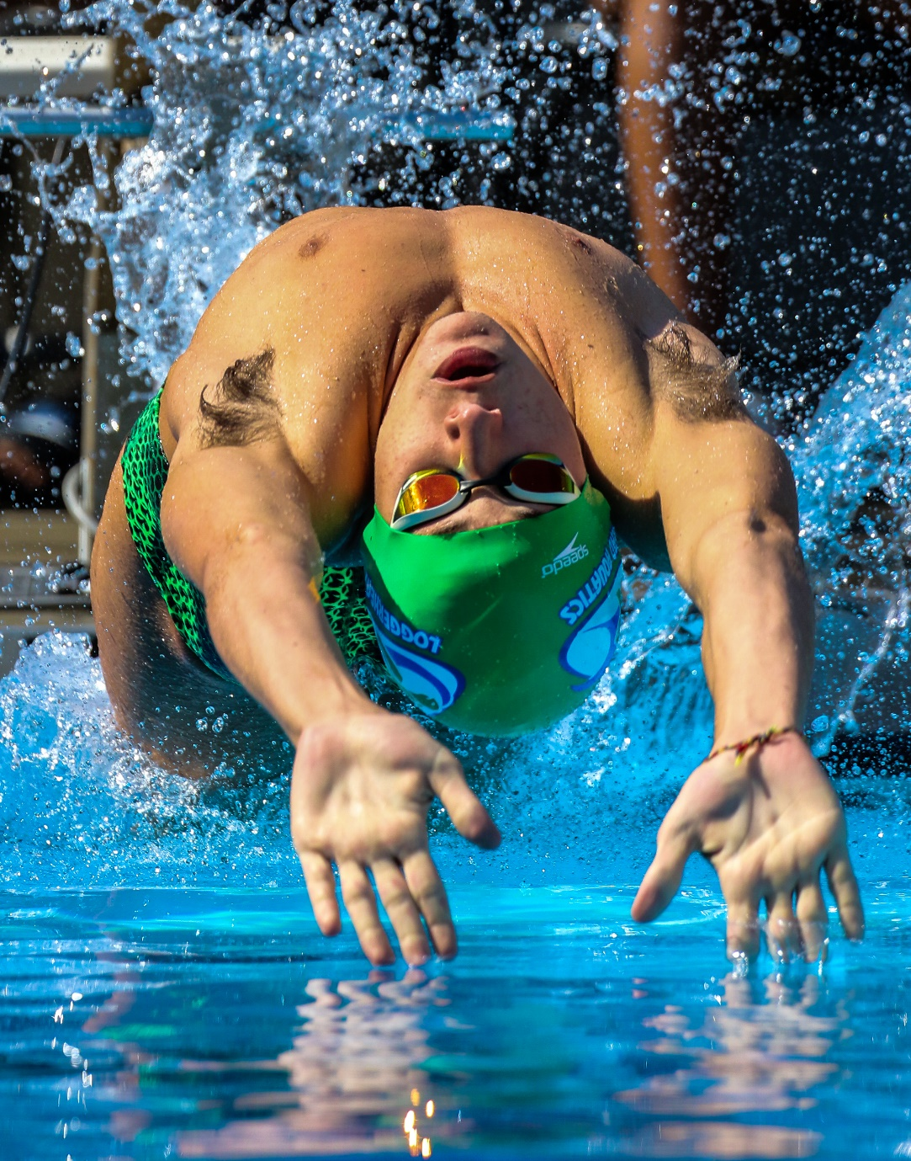
Crop Before you edit your image

Slide 21
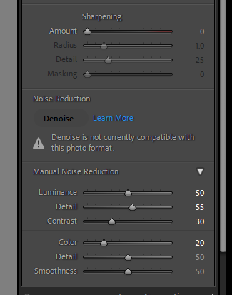
Noise Reduction Images zoomed 1:2
– 1/1000sec; f5.6, ISO 32,000
No NR
NR

Slide 22
Noise Reduction Images zoomed 1:2 – 1/1000sec; f5.6, ISO 32,000
No NR
NR

Slide 23
Wrap Up
Questions?

